Slide 1

Distributed Ledger Technology & Introduction to Blockchain
Dr. Rajesh Kumar
Assistant Professor
Department of AI & DS /EE
Prestige Institute of Engineering Management & Research , Indore
Lecture :DLT & Introduction to Block chain

Slide 2

Course Learning Outcome
“Students will be able to explain DLT, differentiate blockchain generations, and analyze the key features, challenges, and real-world applications of Blockchain 3.0”
Lecture :DLT & Intro to Blockchain

Slide 3
Contents
Introduction to DLT
Blockchain Architecture
Cryptographic Foundations
Consensus Mechanism
Evaluation of Blockchain
Blockchain 3.0
Challenges & Solution
Applications
Assessments
Lecture :DLT & Introduction to Block chain

Slide 4
References
Josh Thompson, ‘Blockchain: The Blockchain for Beginnings, Guilde to Blockchain Technology andBlockchain Programming’, Create Space Independent Publishing Platform, 2017.
Reichental, J. (2022, May). Cryptocurrency foundations [Online course]. LinkedIn Learning. https://www.linkedin.com/learning/cryptocurrency-foundations
Reichental, J. (2023, December). Blockchain basics [Online course]. LinkedIn Learning. https://www.linkedin.com/learning/blockchain-basics
Solomon, M. (2021, July). Building an Ethereum blockchain app: 1 Introduction to blockchain [Online course]. LinkedIn Learning. https://www.linkedin.com/learning/building-an-ethereum-blockchain-app-1-introduction-to-blockchain
Mann, G. S. (2021, June 14). Enterprise blockchain: Hyperledger Fabric in Azure [Online course]. LinkedIn Learning. https://www.linkedin.com/learning/enterprise-blockchain-hyperledger-fabric-in-azure
Lecture :DLT & Introduction to Block chain

Slide 5
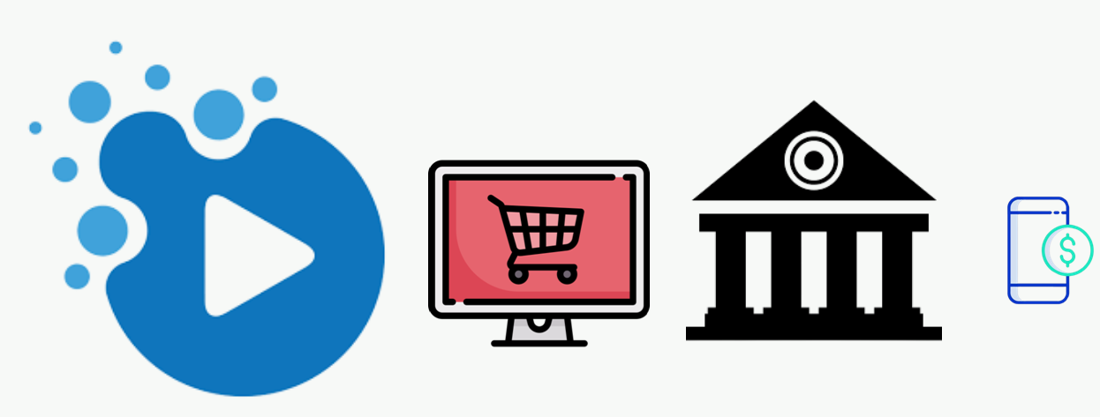
Trust Over Internet
Internet has significantly impacted industries like media and entertainment,
Lecture :DLT & Introduction to Block chain

Slide 6
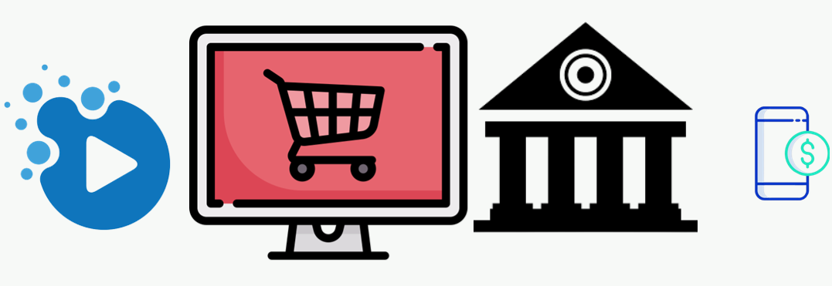
Trust Over Internet
Brick and Mortar Retail,
Lecture :DLT & Introduction to Block chain

Slide 7
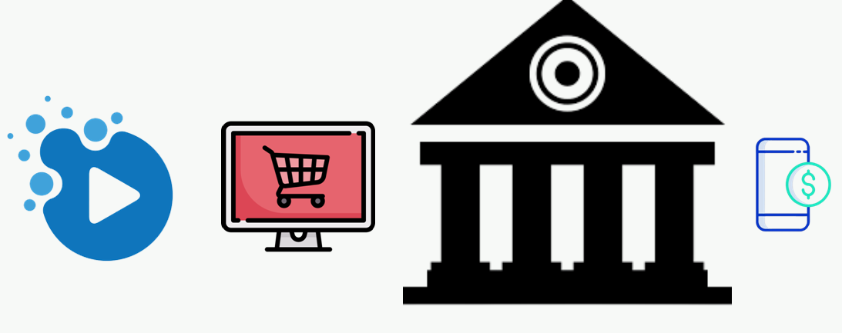
Trust Over Internet
Managing Money and Finance ,
Lecture :DLT & Introduction to Block chain

Slide 8
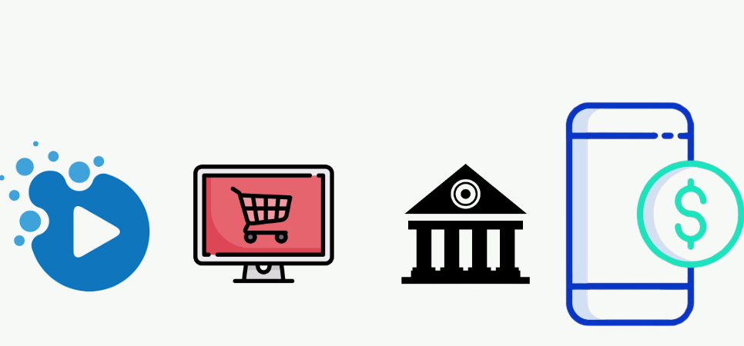
Trust Over Internet
Booking & Travel,
Lecture :DLT & Introduction to Block chain

Slide 9
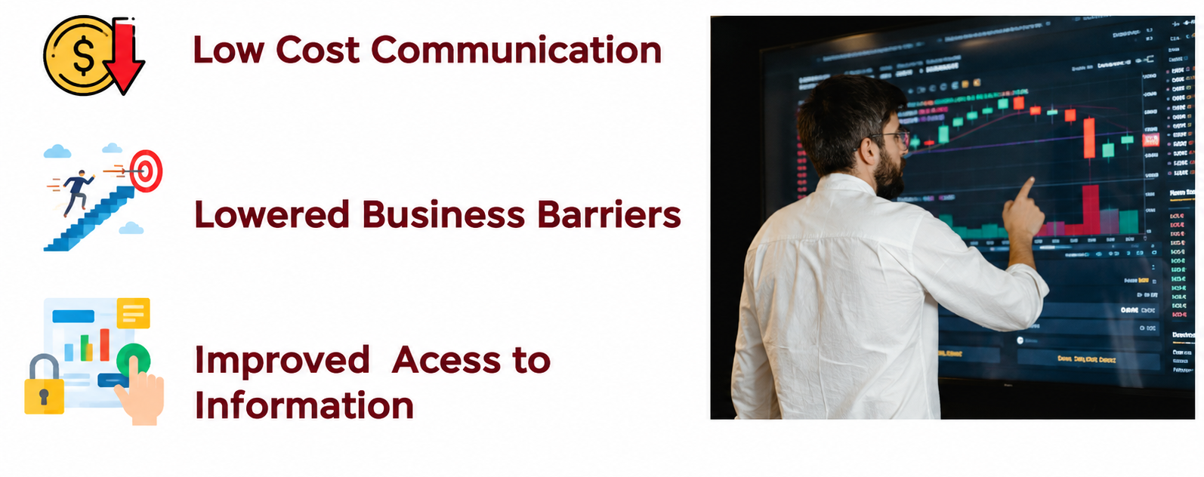
Benefits of Internet
Lecture :DLT & Introduction to Block chain

Slide 10
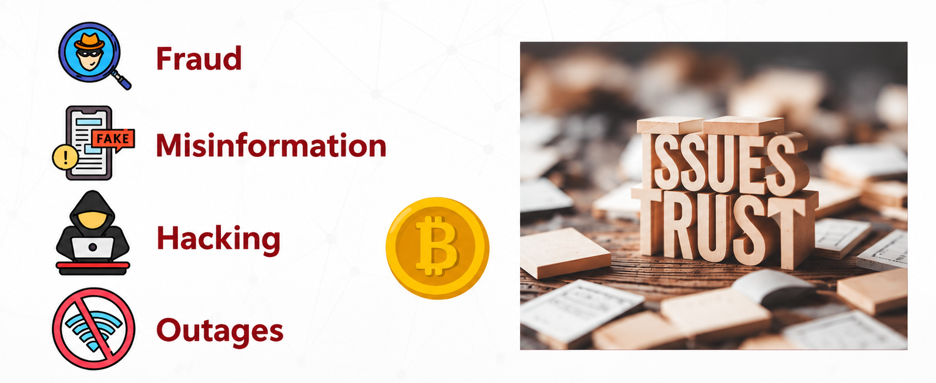
Issues of Trust
Lecture :DLT & Introduction to Block chain

Slide 11
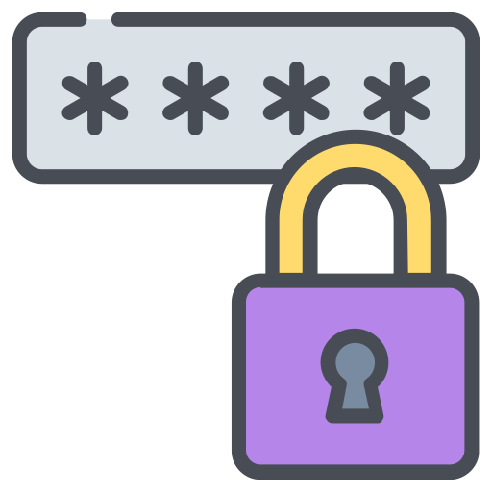
Issues of Trust
Using a stronger password,
Lecture :DLT & Introduction to Block chain

Slide 12
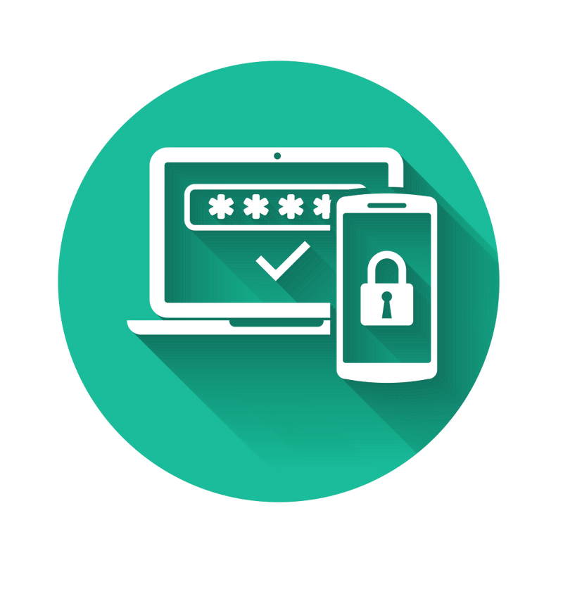
Issues of Trust
Multifactor Authentication,
Lecture :DLT & Introduction to Block chain

Slide 13

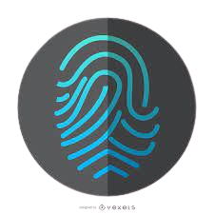
Issues of Trust
Biometrics,
Lecture :DLT & Introduction to Block chain

Slide 14
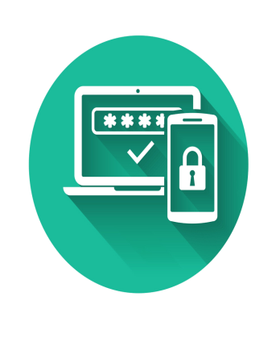
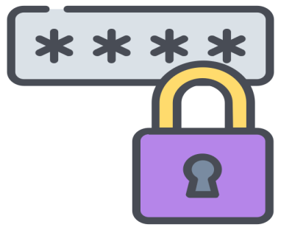

Issues of Trust
Facial Recognitions etc,
Lecture :DLT & Introduction to Block chain

Slide 15
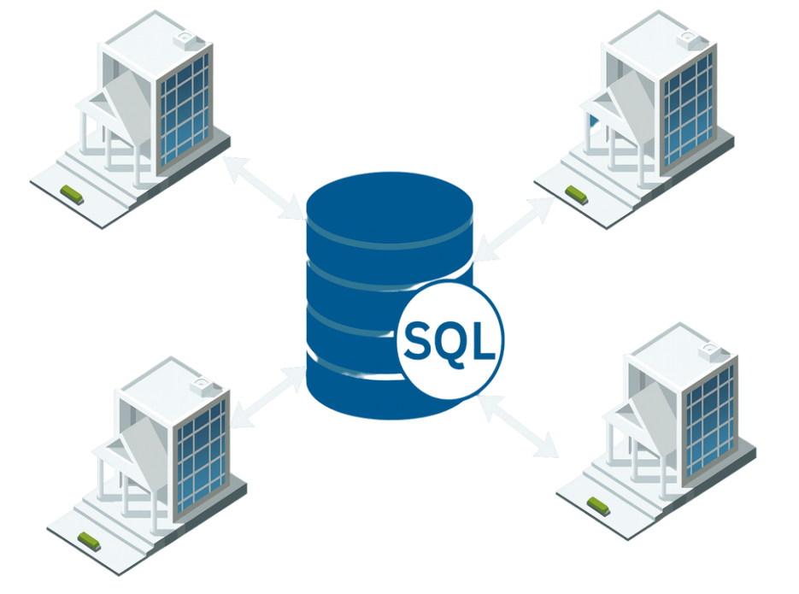
Centralized Systems
The databases typically reside on high performance central computer with access to sizeable storage, it may live in data center at business or third party provider
Lecture :DLT & Introduction to Block chain

Slide 16
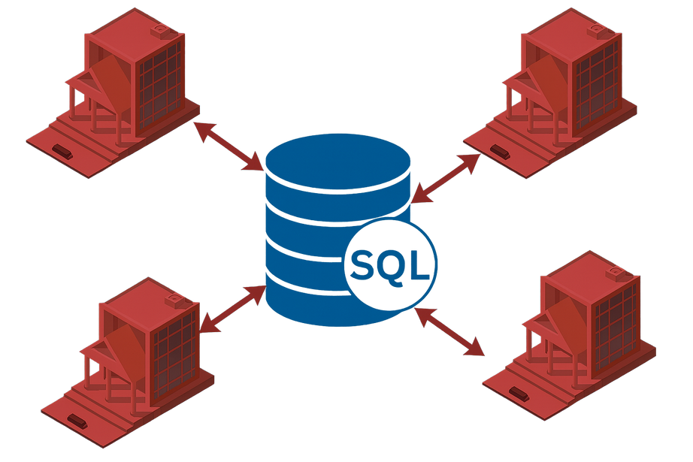
Issues of Trust
But what happens if the databases got some issues?
Lecture :DLT & Introduction to Block chain

Slide 17
Centralized System
What happens if it gets compromised?,
Lecture :DLT & Introduction to Block chain

Slide 18
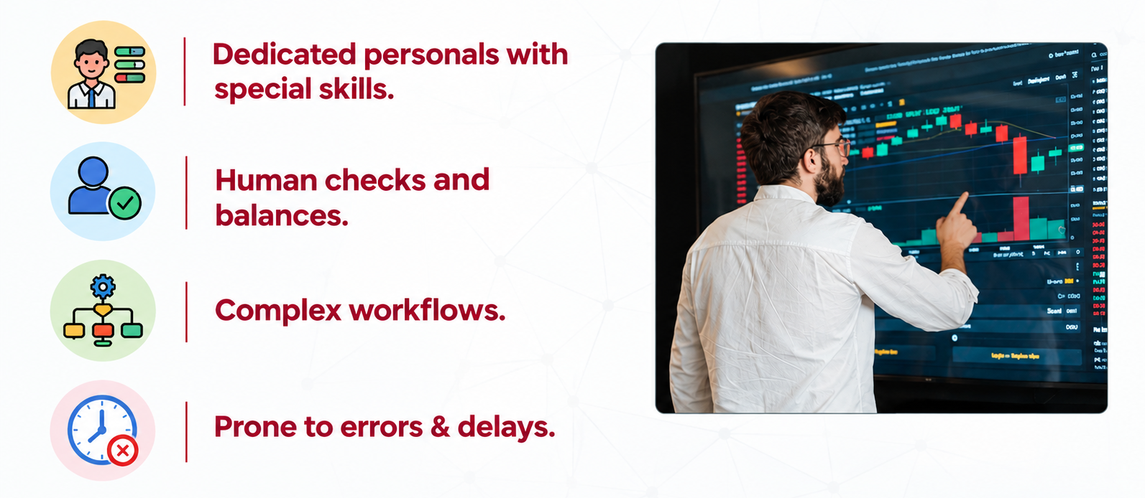
Centralized Systems
Lecture :DLT & Introduction to Block chain

Slide 19
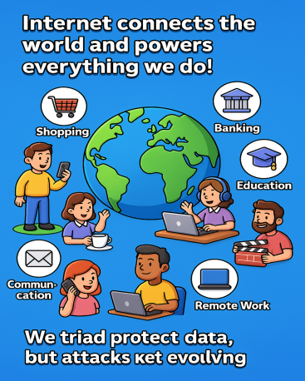

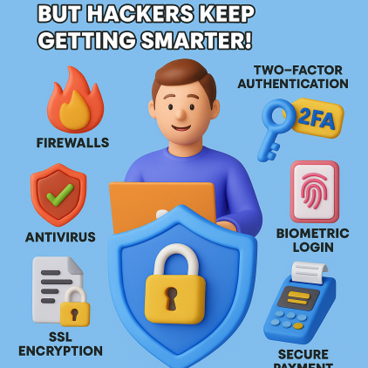
Centralized Systems
Lecture :DLT & Introduction to Block chain

Slide 20
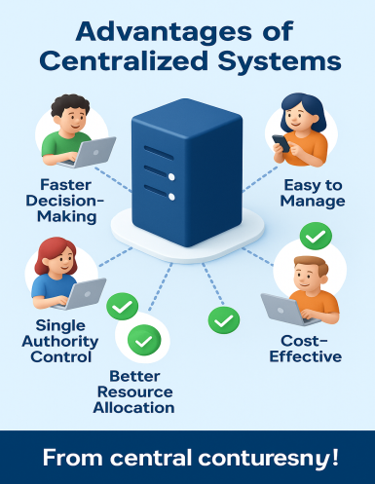
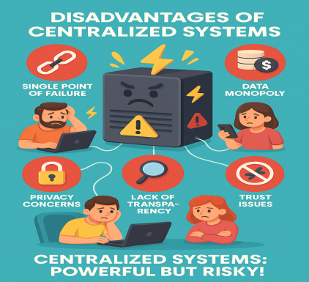
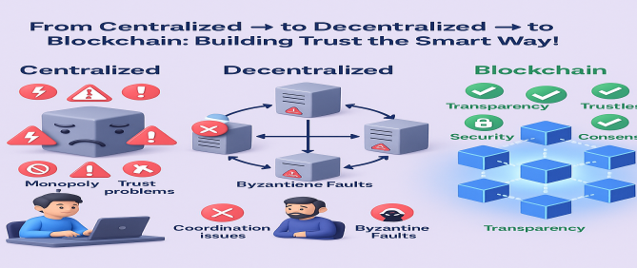
Centralized Systems
Lecture :DLT & Introduction to Block chain

Slide 21
Bitcoin -Satoshi Nakamoto-2008
Bitcoin: A Peer-to-Peer Electronic Cash System- Satoshi Nakamoto
Lecture :DLT & Introduction to Block chain

Slide 22
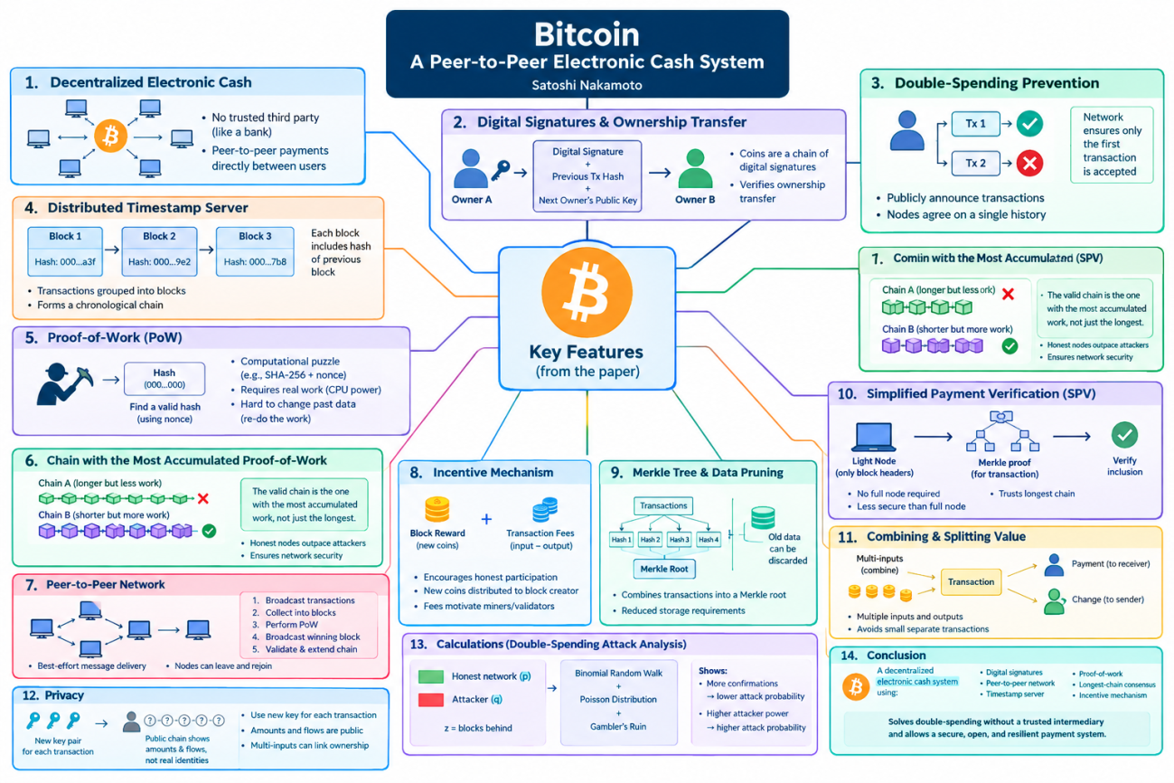
Bitcoin -Satoshi Nakamoto-2008
Bitcoin: A Peer-to-Peer Electronic Cash System- Satoshi Nakamoto
Lecture :DLT & Introduction to Block chain

Slide 23
Bitcoin -Satoshi Nakamoto-2008
Bitcoin: A Peer-to-Peer Electronic Cash System- Satoshi Nakamoto
Lecture :DLT & Introduction to Block chain

Slide 24
Bitcoin -Satoshi Nakamoto-2008
Bitcoin: A Peer-to-Peer Electronic Cash System- Satoshi Nakamoto
Lecture :DLT & Introduction to Block chain

Slide 25
Bitcoin -Satoshi Nakamoto-2008
Bitcoin: A Peer-to-Peer Electronic Cash System- Satoshi Nakamoto
Lecture :DLT & Introduction to Block chain

Slide 26
Bitcoin -Satoshi Nakamoto-2008
Bitcoin: A Peer-to-Peer Electronic Cash System- Satoshi Nakamoto
Lecture :DLT & Introduction to Block chain

Slide 27
Bitcoin -Satoshi Nakamoto-2008
Bitcoin: A Peer-to-Peer Electronic Cash System- Satoshi Nakamoto
Lecture :DLT & Introduction to Block chain

Slide 28
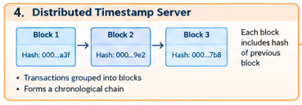
Bitcoin -Satoshi Nakamoto-2008
Bitcoin: A Peer-to-Peer Electronic Cash System- Satoshi Nakamoto
Lecture :DLT & Introduction to Block chain

Slide 29


Bitcoin -Satoshi Nakamoto-2008
Bitcoin: A Peer-to-Peer Electronic Cash System- Satoshi Nakamoto
Lecture :DLT & Introduction to Block chain

Slide 30




Basic Flow
Suppose Rahul want to send 1 BTC to Neha
Lecture :DLT & Introduction to Block chain

Slide 31
Basic Flow
Rahul uses his private key
Lecture :DLT & Introduction to Block chain

Slide 32

Basic Flow
And broadcast his transaction request to entire network
Lecture :DLT & Introduction to Block chain

Slide 33
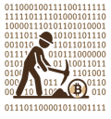
Basic Flow
A set of network participants those with special roles called miners.
Lecture :DLT & Introduction to Block chain

Slide 34
Basic Flow
Works to validate the transaction
Lecture :DLT & Introduction to Block chain

Slide 35
Basic Flow
Lecture :DLT & Introduction to Block chain

Slide 36

Basic Flow
Lecture :DLT & Introduction to Block chain

Slide 37


Basic Flow
Lecture :DLT & Introduction to Block chain

Slide 38
Basic Flow
Its this process that ultimately eliminates double spend problem and ensures high degree of security in the system.
Lecture :DLT & Introduction to Block chain

Slide 39
Basic Flow
If the miners reach the consensus that the transaction is valid. It is proved and added.
Once the transaction is added then Neha uses her key.
Lecture :DLT & Introduction to Block chain

Slide 40
Basic Flow
And the transaction is hence done , time stamped and remain in the auditable trail of blockchain.
Lecture :DLT & Introduction to Block chain

Slide 41
Basic Definition
Distributed Ledger Technology (DLT) is a way of storing and maintaining records across multiple computers or organizations, rather than keeping one master database controlled by a single central authority.
The participating computers synchronize the ledger and use agreed rules—often called a consensus mechanism—to determine which updates are valid.
Think of it as a shared digital record book. Suppose five banks maintain the same transaction ledger. When a new transaction occurs, the network validates it according to its rules, records it, and synchronizes the updated information among the relevant participants. This can reduce reliance on one central database and make unauthorized alteration of records more difficult.
Lecture :DLT & Introduction to Block chain

Slide 42
Most Popular DLT: Blockchain Technology
What is Blockchain?
Lecture :DLT & Introduction to Block chain

Slide 43
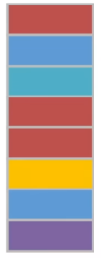
Most Popular DLT: Blockchain Technology
What is Blockchain?
Time Stamped Append Only Log
Lecture :DLT & Introduction to Block chain

Slide 44
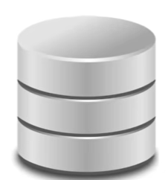
Most Popular DLT: Blockchain Technology
What is Blockchain?
Auditable Database
Time Stamped Append Only Log
Lecture :DLT & Introduction to Block chain

Slide 45
Most Popular DLT: Blockchain Technology
What is Blockchain?
Auditable
Time Stamped Append Only Log
Secured via cryptography
Lecture :DLT & Introduction to Block chain

Slide 46
Most Popular DLT: Blockchain Technology
What is Blockchain?
Auditable Database
Time Stamped Append Only Log
Secured via cryptography
Hash functions for tamper resistance & integrity
Lecture :DLT & Introduction to Block chain

Slide 47
Most Popular DLT: Blockchain Technology
What is Blockchain?
Auditable Database
Time Stamped Append Only Log
Secured via cryptography
Hash functions for tamper resistance & integrity
Digital Signatures for Consent
Lecture :DLT & Introduction to Block chain

Slide 48
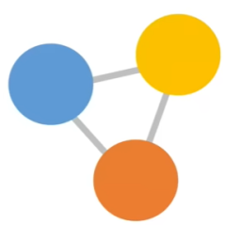
Most Popular DLT: Blockchain Technology
What is Blockchain?
Consensus Protocol
Auditable Database
Time Stamped Append Only Log
Secured via cryptography
Hash functions for tamper resistance & integrity
Digital Signatures for Consent
Lecture :DLT & Introduction to Block chain

Slide 49
Most Popular DLT: Blockchain Technology
What is Blockchain?
Blockchain is a digital system for recording information or transactions in a way that is shared, transparent, and difficult to alter.
It stores data in groups called blocks. Each block is connected to the previous one using cryptography, forming a chain of blocks—hence the name blockchain.
Lecture :DLT & Introduction to Block chain

Slide 50
Most Popular DLT: Blockchain Technology
Major Components of Blockchain
Blocks:
A block stores a collection of validated transactions along with information such as
its timestamp, previous block;s hash, and its own hash.
Lecture :DLT & Introduction to Block chain

Slide 51
Most Popular DLT: Blockchain Technology
Major Components of Blockchain
Hash Values:
A hash is a unique-looking cryptographic value generated from the block;s data.
Even a small change in the block data produces a different hash, helping to detect tampering.
Blocks:
A block stores a collection of validated transactions along with information such as
its timestamp, previous block;s hash, and its own hash.
Lecture :DLT & Introduction to Block chain

Slide 52
Most Popular DLT: Blockchain Technology
Major Components of Blockchain
Chain Structure: Each block link to previous via Hashing
Blocks:
A block stores a collection of validated transactions along with information such as
its timestamp, previous block;s hash, and its own hash.
Hash Values:
A hash is a unique-looking cryptographic value generated from the block;s data.
Even a small change in the block data produces a different hash, helping to detect tampering.
Lecture :DLT & Introduction to Block chain

Slide 53
Most Popular DLT: Blockchain Technology
Distributed Network: Copies Maintained by multiple Nodes
Major Components of Blockchain
Chain Structure: Each block link to previous via Hashing
Blocks:
A block stores a collection of validated transactions along with information such as
its timestamp, previous block;s hash, and its own hash.
Hash Values:
A hash is a unique-looking cryptographic value generated from the block;s data.
Even a small change in the block data produces a different hash, helping to detect tampering.
Lecture :DLT & Introduction to Block chain

Slide 54
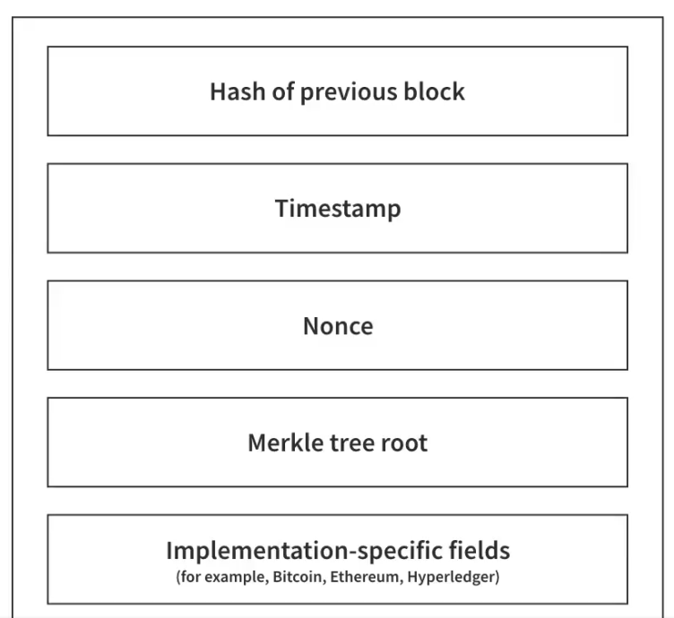
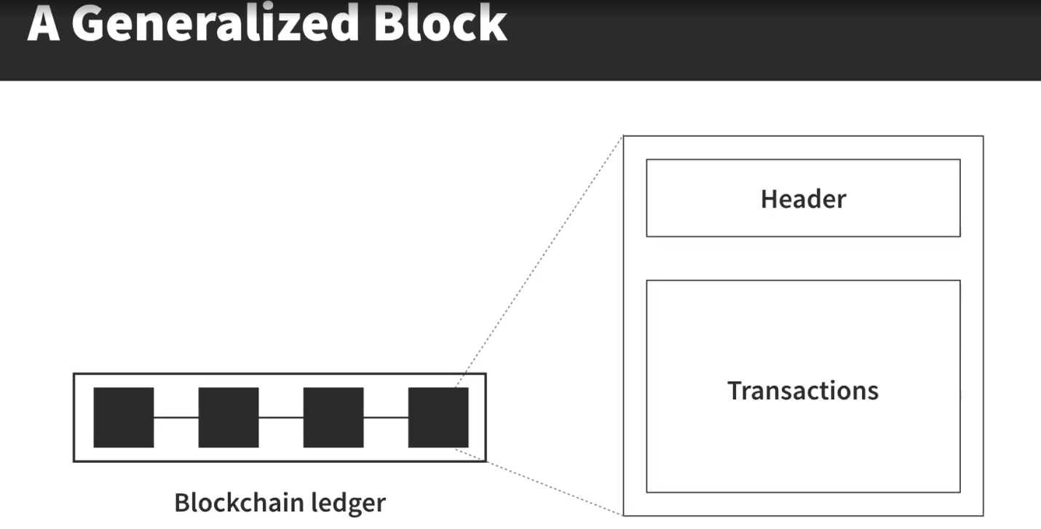
Most Popular DLT: Blockchain Technology
Generalized Block
Lecture :DLT & Introduction to Block chain

Slide 55
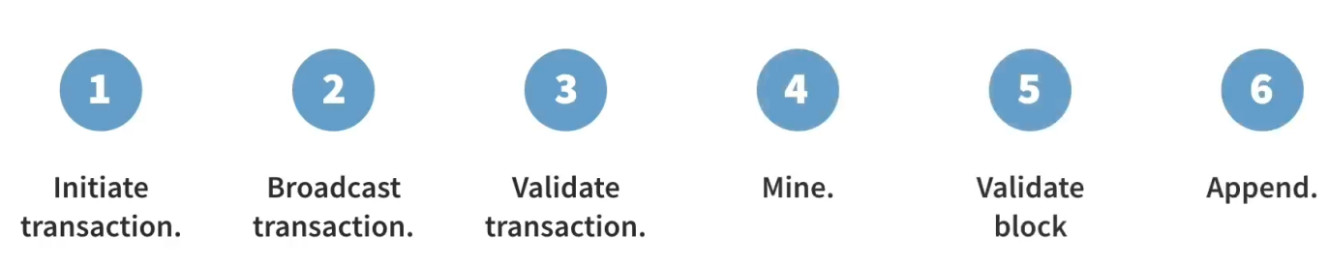
Most Popular DLT: Blockchain Technology
Step by Step Process to Append a Block
Lecture :DLT & Introduction to Block chain

Slide 56
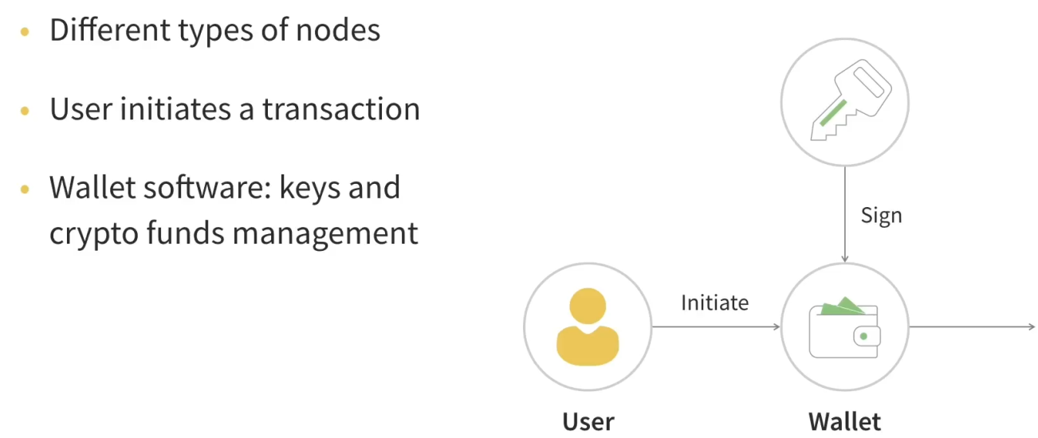
Most Popular DLT: Blockchain Technology
Initiate a Transaction
Lecture :DLT & Introduction to Block chain

Slide 57
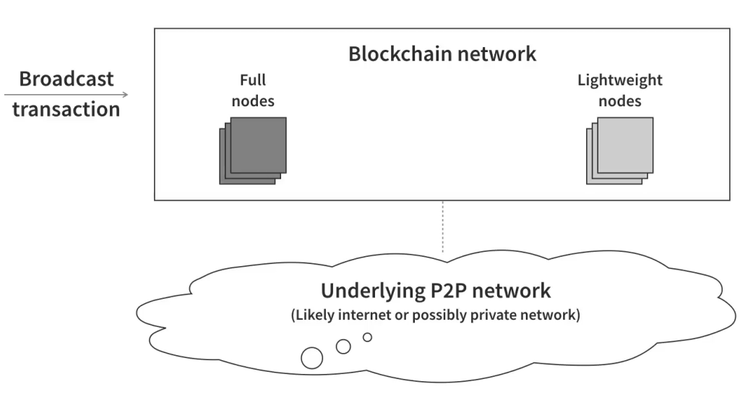
Most Popular DLT: Blockchain Technology
Broadcast the Transaction
Lecture :DLT & Introduction to Block chain

Slide 58
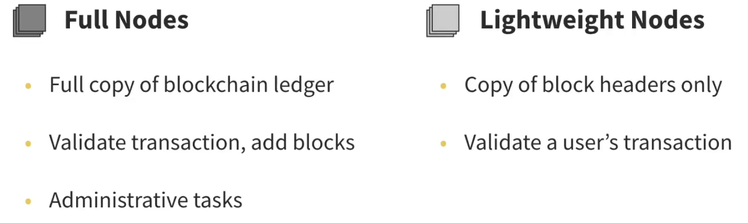
Most Popular DLT: Blockchain Technology
Network of Nodes
Lecture :DLT & Introduction to Block chain

Slide 59
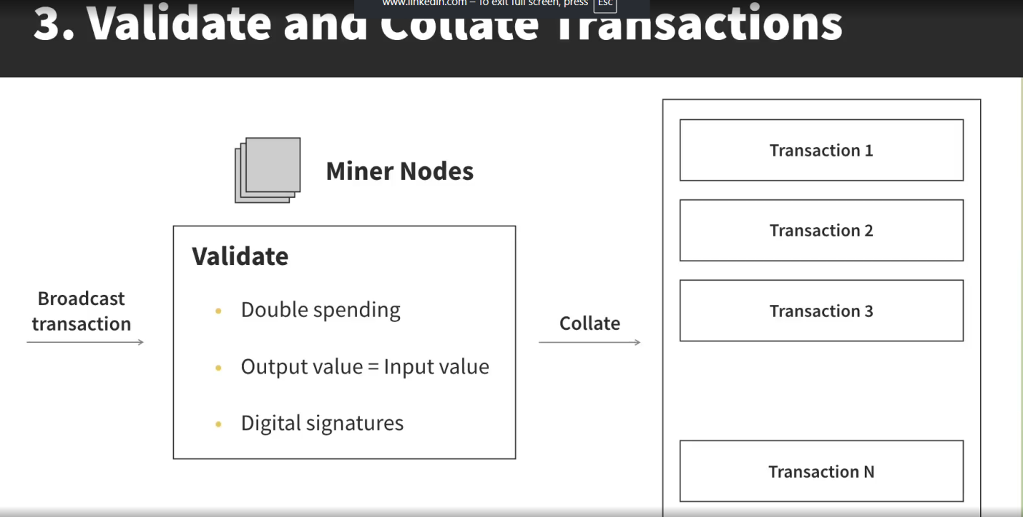
Most Popular DLT: Blockchain Technology
Validate & Collate Transaction
Lecture :DLT & Introduction to Block chain

Slide 60
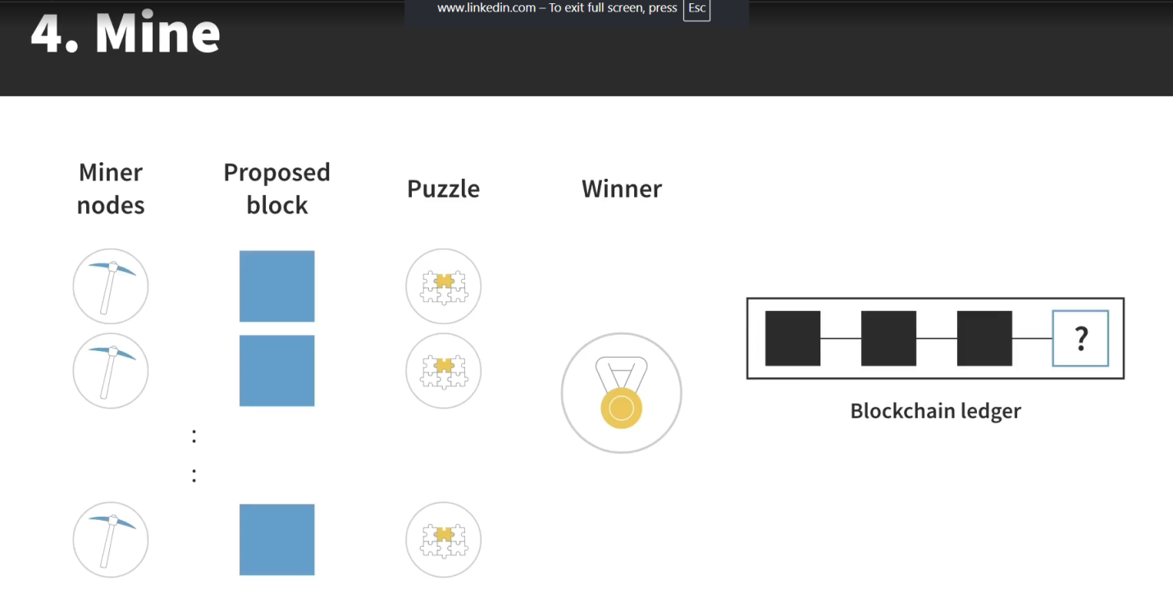
Most Popular DLT: Blockchain Technology
Mine
Lecture :DLT & Introduction to Block chain

Slide 61
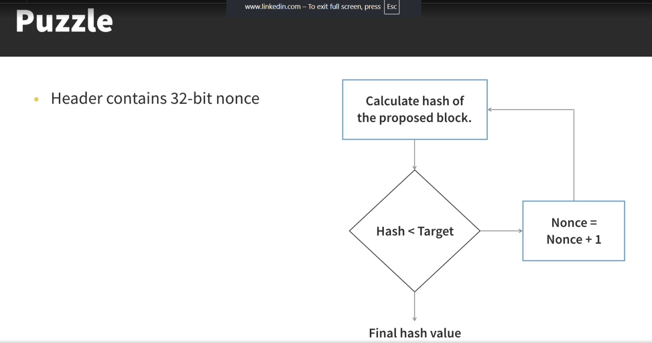
Most Popular DLT: Blockchain Technology
Puzzle
Lecture :DLT & Introduction to Block chain

Slide 62
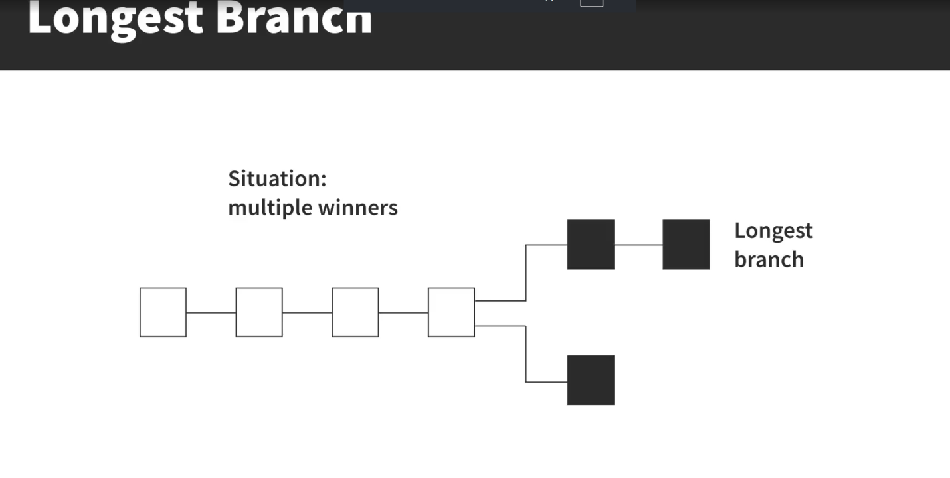
Most Popular DLT: Blockchain Technology
Longest Branch
Lecture :DLT & Introduction to Block chain

Slide 63
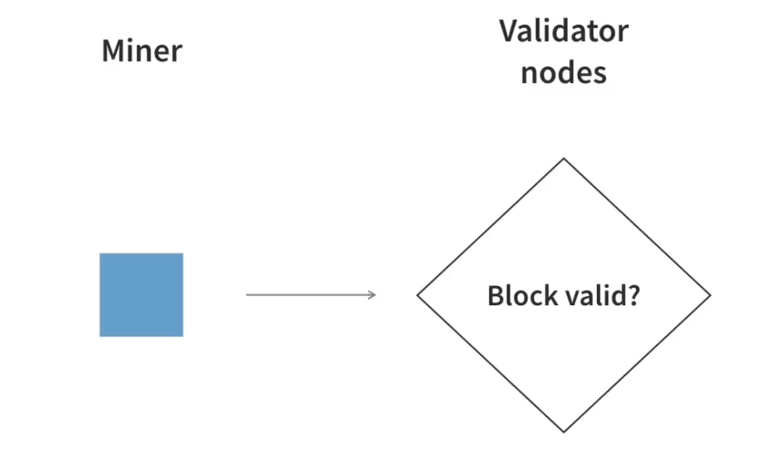
Most Popular DLT: Blockchain Technology
Validate Mine Block
Lecture :DLT & Introduction to Block chain

Slide 64
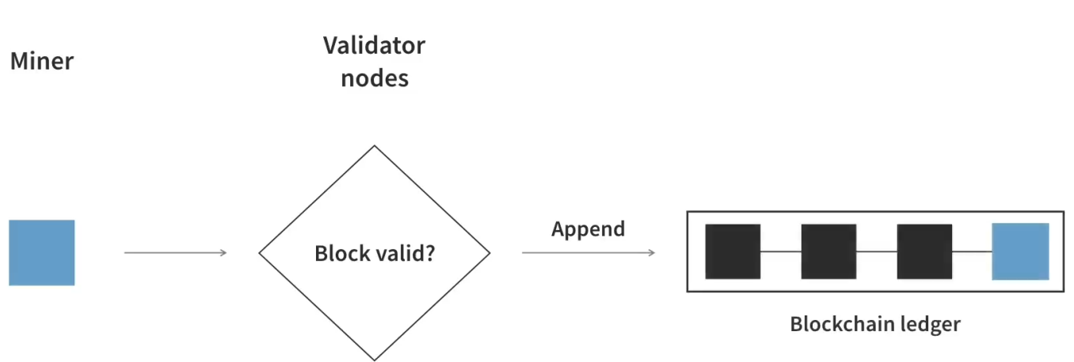
Most Popular DLT: Blockchain Technology
Append the Block
Lecture :DLT & Introduction to Block chain

Slide 65
Most Popular DLT: Blockchain Technology
What Problem does Blockchain Solves?
Lecture :DLT & Introduction to Block chain

Slide 66
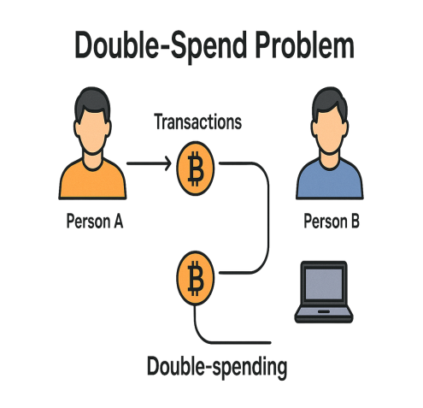
Most Popular DLT: Blockchain Technology
What Problem does Blockchain Solves?
Lecture :DLT & Introduction to Block chain

Slide 67
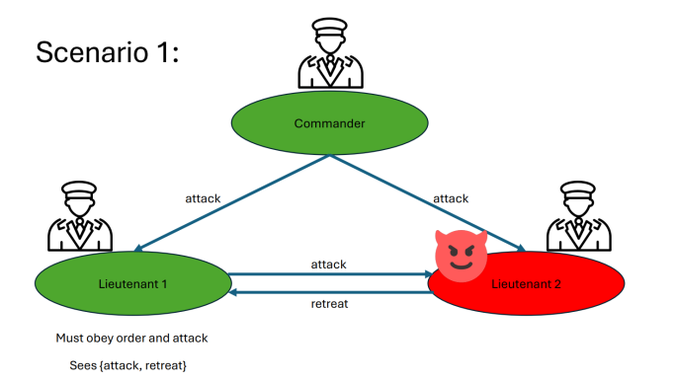
Most Popular DLT: Blockchain Technology
What Problem does Blockchain Solves?
Lecture :DLT & Introduction to Block chain

Slide 68
Most Popular DLT: Blockchain Technology
What Problem does Blockchain Solves?
Lecture :DLT & Introduction to Block chain

Slide 69
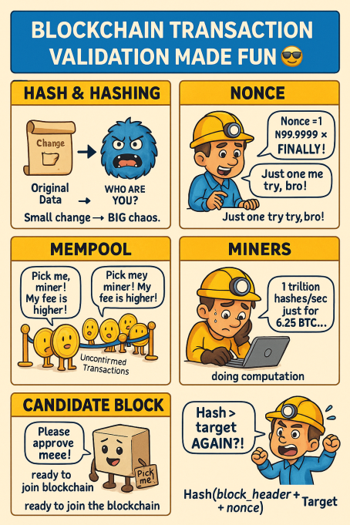
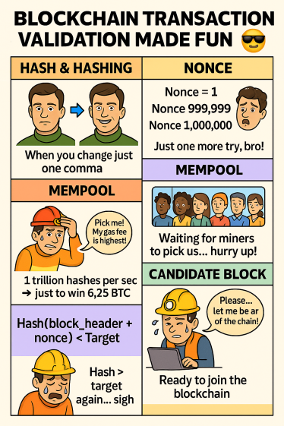
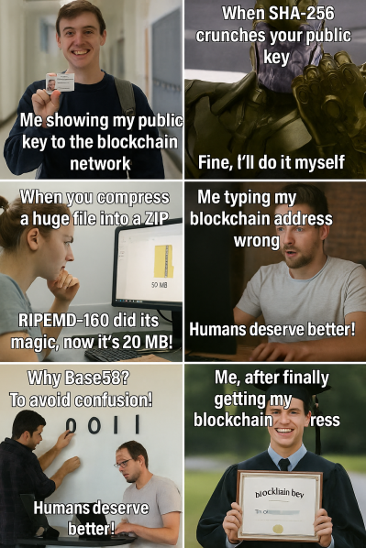
Most Popular DLT: Blockchain Technology
Lecture :DLT & Introduction to Block chain

